Slide 1
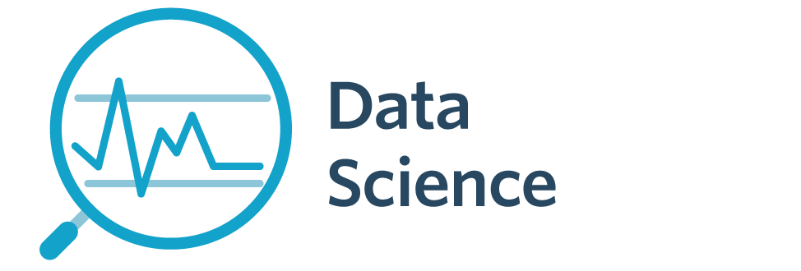

7143CEM Mini-lecture 3-3b: Data Security
School of Computing, Electronics and Mathematics Coventry University
7143CEM Programming for Data Science 2021/22 Semester 2

Slide 2
Information Commissioner’s Office (ICO)
https://ico.org.uk/
The UK’s independent authority set up to regulate data protection in the UK.
Promote openness and accountability by companies and public bodies.
Guarding data privacy for individuals.
Enforce legislation through issuing fines to organisations.
“We offer advice and guidance, promote good practice, carry out audits, consider complaints, monitor compliance and take enforcement action where appropriate.”
Notes:
Reading: https://owasp.org/www-project-top-ten/
https://www.synopsys.com/glossary/what-is-owasp-top-10.html
https://blog.threatpress.com/security-design-principles-owasp/

Slide 3
What is a Data Breach?
Accidental or unlawful destruction, loss, alteration, unauthorised disclosure of, or access to, personal data.
access by an unauthorised third party;
deliberate or accidental action (or inaction) by a controller or processor
sending personal data to an incorrect recipient
computing devices containing personal data being lost or stolen
alteration of personal data without permission
loss of availability of personal data
Notes:
Source: https://ico.org.uk/for-organisations/guide-to-data-protection/guide-to-the-general-data-protection-regulation-gdpr/personal-data-breaches/

Slide 4
Notification and Fines
Breach notification Organisation must report a breach of personal data to the ICO within 72 hours of becoming aware of the breach, if possible.
Fines Maximum fine of £17.5 million or 4% of annual global turnover (whichever is greater).
Notes:
Reading: https://www.itgovernance.co.uk/dpa-and-gdpr-penalties

Slide 5
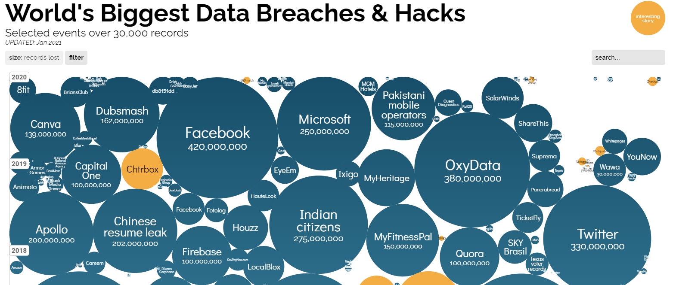
Data Breaches (or Poor Processes)
Notes:
Source: https://www.informationisbeautiful.net/visualizations/worlds-biggest-data-breaches-hacks/

Slide 6
Data Breaches (or Poor Processes)
Amazon (2021) cookie consent, fine of €746million
H&M Germany (2020), fine of €35million
Telecom Italia (2020), fine of €27million
Google (2019) privacy notice, fine of €50million
Tesco/Boots (2020) loyal card details leaked
Virgin Media (2020) marketing database not secure

Slide 7
Data Breaches (or Poor Processes)
British Airways (2018) customer details (fined €22million, originally £183million)
Marriott hotels (2018) passport numbers, reservation details (fined €20million)
Dixons Carphone (2018) 1.2 million customer records compromised
Coventry University (2017, before GDPR)
Notes:
Source: https://www.itgovernance.co.uk/blog/coventry-university-investigated-after-data-breach
Source: https://www.which.co.uk/news/2020/03/boots-advantage-card-tesco-clubcard-both-suffer-data-breaches-in-same-week/
https://www.itgovernance.co.uk/blog/coventry-university-investigated-after-data-breach

Slide 8
Example: British Airways (2018)
Data breach affected 400000 customers
244000 customer full name, address, payment card details
Information Commissioner’s Office (ICO) fined BA £183million (1.5% of BA global turnover in 2018), later reduced to £20milllion.
Supply chain attack.
Username/password login only, unrestricted access.

Slide 9

Example: Cambridge Analytica
Facebook App: “This is Your Digital Life”, psychographic profiling (personality, values, attitudes, lifestyle, interests)
Harvested data from App users (with consent) and their Facebook friends (without consent)
87 million Facebook user’s data
Influenced the 2016 US Presidential election (micro targeting advertising)
“The Great Hack” (2019 Netflix documentary)
Notes:
Reading: https://www.nytimes.com/2018/04/04/technology/mark-zuckerberg-testify-congress.html

Slide 10
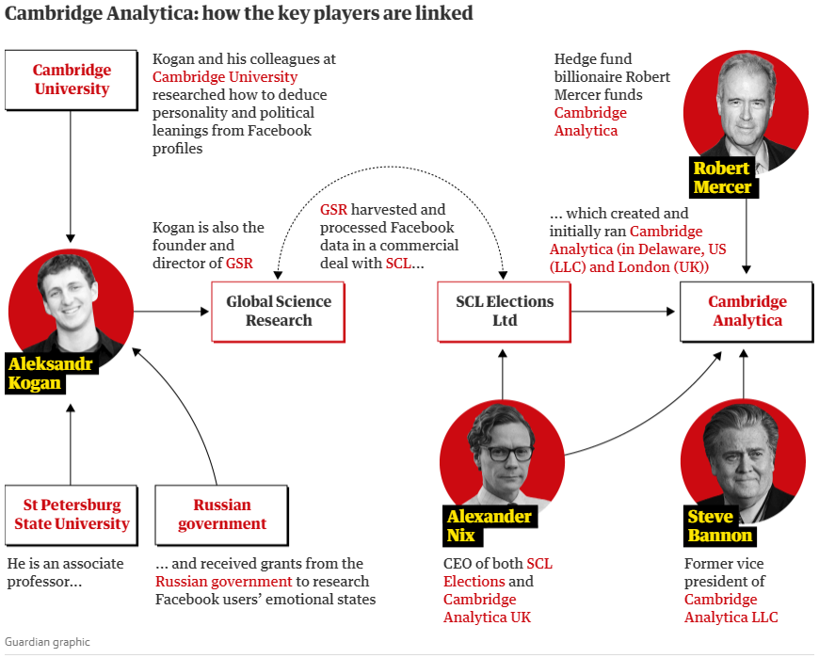
Example: Cambridge Analytica
Notes:
https://www.theguardian.com/news/2018/mar/17/cambridge-analytica-facebook-influence-us-election

Slide 11
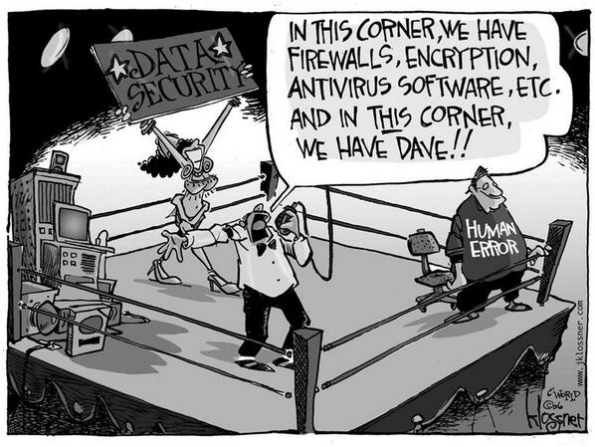
Data Security
Notes:
Image from: https://blogs.windriver.com/wind_river_blog/2016/12/prevent-human-error-in-security-dave-meet-stig-stig-meet-dave/

Slide 12
Data Security
Protecting digital data from destructive forces and from unwanted actions of unauthorised uses.
cyber attack, data breach
cryptography, digital signatures, authentication
hardware/software/human levels
data masking, e.g., credit card number shows only few digits
data erasure
Attackers
Disgruntled staff, drive-by attackers, cybercriminals, criminal organisations, script kiddies

Slide 13
Data Security
Open Web Application Security Project (OWASP)
OWASP Top Ten Security Risks
injection of code
broken authentication, e.g., weak passwords
sensitive data exposure
Pillars of data security
Confidentiality – only allow access to data permitted for user
Integrity – ensure data not altered by unauthorised users
Availability – ensure data available to authorised users
Notes:
Reading: https://owasp.org/www-project-top-ten/
https://www.synopsys.com/glossary/what-is-owasp-top-10.html
https://blog.threatpress.com/security-design-principles-owasp/

Slide 14
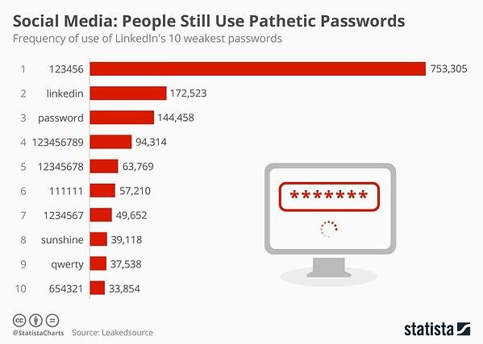
Data Security
Notes:
Source: https://www.doherty.co.uk/blog/data-breach-examples-rethink-your-data-strategy

Slide 15
Summary
Data Breach
Accidental or unlawful destruction, loss, alteration, unauthorised disclosure of, or access to, personal data.
Notify ICO within 72 hours, large fines possible
Data Security
Hardware, software, and human
Document policies and protective measures
Identify, evaluate and reduce risks
Notes:
Reading: https://owasp.org/www-project-top-ten/
https://www.synopsys.com/glossary/what-is-owasp-top-10.html
https://blog.threatpress.com/security-design-principles-owasp/

